Slide 1

An Introduction to AI Text-Generation Software
Artificial intelligence text-generation software has become ubiquitous in the modern world.
In this presentation, we will cover the potential benefits and risks of using such technology and provide guidelines on how to use it safely and ethically.

Slide 2
What are LLMs?
1
AI Text Generators
3
Generalization & Creativity
Designed to generate human-like text based on the input they receive. They can answer questions, write essays, summarize documents, and even create poetry.
Can generate text on a wide range of topics. They can even produce creative and unique responses that were not explicitly present in their training data.
2
Training Process
4
Limitations & Ethics
Trained on massive amounts of text data, learning patterns, structures, and context from this data. They do not "understand" the text but make predictions based on statistical patterns they've identified during training.
May generate inaccurate or biased information. Additionally, they raise ethical concerns, such as privacy, misinformation, and manipulation, which need to be carefully considered and managed.
Notes:
Large Language Models

Slide 3

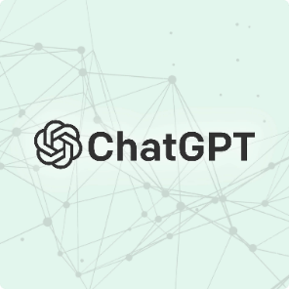

Not Just One Tool
Bing Chat
ChatGPT
Claude 2
Powered by ChatGPT, Bing Chat can search the internet and link to current sources.
The leading standard for AI text-generation tools. Has plugins for math, programming, and additional functionality.
Chatbot that can read uploaded text documents and hold long conversations in memory.
Notes:
Bing Chat, ChatGPT, Bard AI, Claude, Perplexity.AI, etc. Each have strengths & weaknesses, and specializations.
For example, Claude is very good at creative writing, and can “read” really long prompts and remember long exchanges with the user. You can upload documents that it can review and understand (up to ~70,000 words).

Slide 4

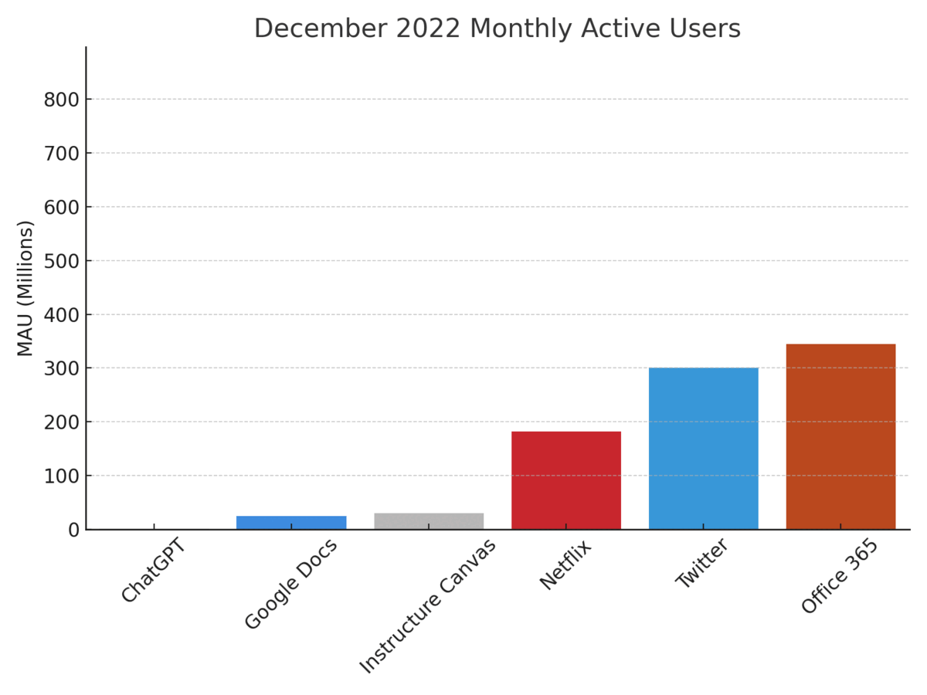

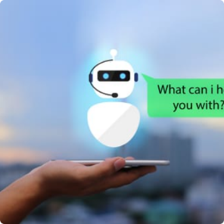
The Rise of AI Text-Generation Software
In the Workplace
Everyday Life
Education
AI-generated text is being used in the workplace to automate administrative tasks, write reports, and draft emails.
From voice assistants to spell-checkers, AI text-generation software is a part of our daily lives.
Chatbots and other AI-powered tools are being used to provide personalized learning experiences to students.
Notes:
It will impact everyone differentially per your discipline
Potential to be harmful—job fields or careers will drastically change, shrink, or disappear
How are your future colleagues using it?
How can you use it as a tool?

Slide 5
Pitfalls of AI-generated Text
1
Misinformation
3
Plagiarism
AI-generated text can be misleading or contain false information. It's important to verify the accuracy and reliability of the information.
AI-generated text can be used to generate content that people try to pass off as entirely their own.
2
Bias
AI can inadvertently perpetuate harmful stereotypes or biases because the data used to train the model is biased.

Slide 6
Verifying the Accuracy and Reliability of AI-generated Text
Verify w/ Credible
Sources
Check the Math/Examples
Check the Sources!
Verify the information using credible sources such as news articles from respected publications, scholarly articles, and books.
Read generated text carefully and critically, making certain that any examples, math, or right/wrong answers are actually true.
AI-generated text will often have links or references. Do not trust that these are real.
Notes:
Credible Sources example: https://news.northwestern.edu/stories/2023/01/chatgpt-writes-convincing-fake-scientific-abstracts-that-fool-reviewers-in-study/
Vanilla ChatGPT (Without the CodeInterpreter or WolframAlpha Plugins) is terrible at math. It will also generate fake quotes, “examples” that are incorrect, and sources that don’t exist.
Check the Sources example: https://www.reuters.com/legal/transactional/lawyer-used-chatgpt-cite-bogus-cases-what-are-ethics-2023-05-30/

Slide 7
Tips for Using AI-generated Text Effectively and Responsibly
1
Context Matters
AI-generated text should always be used in the appropriate context and not presented as the work of a human author.
Be Prepared to Edit
2
AI-generated text often requires editing to ensure coherence, clarity, and accuracy.
3
Consistency is Key
Establish a consistent habit of checking the work and content of the AI. You are responsible for what’s submitted under your name!
Cite Your Tools & AI Threads
4
You are expected to make it clear when you’ve used an AI text generation tool, and how you’ve used it.
Notes:
What is "original" student work, and when do we most want it, and for what (educational/growth/ethical) purposes?
How can responsible writers and professionals incorporate the use of AI text generators going forward?

Slide 8
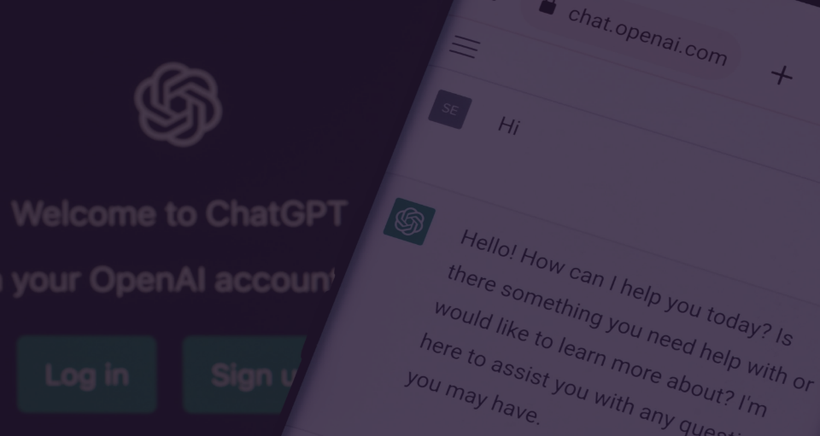
Academic Honesty Policy at ECC:
ChatGPT in Action
AI-generated work (text, code, images, videos, etc.) without proper citation is not
accepted at ECC as “the student’s own work.”
Let's take a closer look at ChatGPT, an AI-powered chatbot that can generate
human-like responses to user queries.
Notes:
Open up ChatGPT and run through some sample prompts to show strengths, weaknesses, and use cases.
Then:
You should always consult with individual teachers about the policies in their individual classes.
You must cite the AI you’ve used if you use it. We will discuss at a later date how you are expected to do this so you can avoid facing disciplinary action here at ECC.
Examples: using text generation software to generate text for an essay without citing the prompt, software used, and un-edited generated text; utilizing AI tools to automate the paraphrasing of source text(s) without clearly citing the source material, which tool was used, and all changes made by the tool; making use of AI tools to significantly rework your own writing (including tools that automatically ‘correct’ grammar and punctuation through substantial rewrites) without clearly indicating the type of tool used and the extent of changes made by the tool; using image generation software to complete a graphic design assignment without providing the prompt, software used, and un-edited generated image; completing coding work by prompting a text generator to create and iterate said code without providing the prompt, software used, and the un-edited generated code.

Slide 9


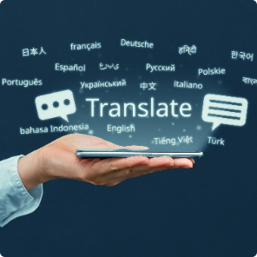
Now You Try!
Educational Use
Career Advice
Translation
You can use AI text-generation tools to improve your skills , knowledge, and abilities.
You can use AI to generate career advice, help with cover letters and resumes, and to conduct practice interviews.
You can use AI to translate text, ideas, and information into a format that you or others are more likely to understand or respond to.
Notes:
Create an account and start prompting the AI. Think of some of the ways it can help you. Can it tutor you in a topic you’re struggling with? Can it help you compose a difficult email or letter? Can it explain a concept that’s foreign to you, like coding or medical terminology? What works? What DOESN’T work? Make sure you’re actually reading the answers carefully and checking for accuracy!

Slide 10
The Broader Implications of AI in Society
Benefits
Concerns
Increased efficiency
Job displacement
Improved accuracy
Social inequality
New job opportunities
Lack of transparency
As AI technology continues to advance, it's important to consider its potential impact on society and take measures to ensure its development is ethical and responsible. What are the dangers? What role do you play?
Notes:
We are currently “beta” testing software like this – best practices and usage rules will change rapidly. Nothing we say or do here is set in stone.
How are current AI text generators in a "free" mode likely to progress toward a for-profit approach, and how will that affect students and young professionals in the future?
How good is the AI at going beyond its programming? For example, an algorithm built to identify good managers would use data from people who are currently good managers, and because current managers have a bias toward xyz, the algorithms will bias toward xyz. Text generated by AI might have the same problem.
When this gets better, and more nuanced and universal applications are available, what are the things that humans will no longer need to do - what tasks will no longer be needed?
Skills are evolving as a result
Can we spend more time in deeper thought and not have to take the time to do more task based or lower-level thinking and discussion?
AI Chatbots can seem human. What should be considered “healthy” interactions with an AI chatbot?
Professional advice, personal advice, and even therapy may be something people seek from chatbots. In some senses, these bots can help keep people emotionally healthy!
But how do we prevent healthy connections from transforming into something that harms the “user” of a non-sentient program that appears to be a thoughtful human which is chameleon-like in shaping itself to what each person needs or wants?
Is a generation that has grown up used to forming digital connections with online strangers particularly susceptible (or are they more ‘inoculated’) to this?
When is it always unacceptable to use AI text generators?
Discuss Vanderbilt example.
What will students need to do to be “good writers” as educated professionals, as AI text generators continue to gain facility in generating accurate and relevant text? (Prompts!)

